Slide 1
Comprehensive Digital Marketing Project work

Slide 2
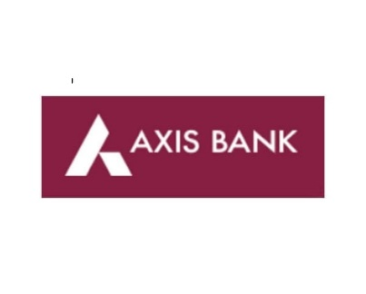
Part 1: Brand study, Competitor Analysis & Buyer’s/Audience’s Persona
COMPANY/TOPIC for project : AXIS BANK
Research Brand Identity: Study the brand's mission, values, vision, and unique selling propositions (USPs).
Brand colours :
Marooon , white
Logo :
Misson/Values :
Axis Bank's mission is to be the preferred financial solutions provider excelling in customer delivery through insight, empowered employees and smart use of technology.
USP :
Axis Bank is one of the largest private sector financer in Indian agriculture

Slide 3
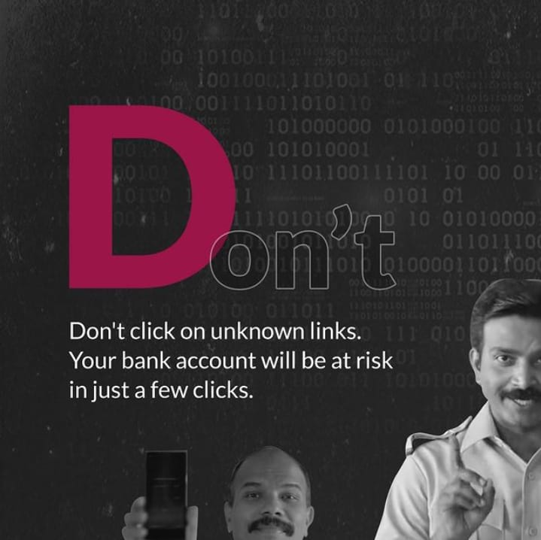

Part 1: Brand study, Competitor Analysis & Buyer’s/Audience’s Persona
COMPANY/TOPIC for project : AXIS BANK
Brand Messaging : Informative & Awareness
https://www.instagram.com/p/CvFCJ_BLL_D/?igshid=NTc4MTIwNjQ2YQ==
Tagline : We are just the bank you need

Slide 4
Part 1: Brand study, Competitor Analysis & Buyer’s/Audience’s Persona
Competitor Analysis: Select three competitors operating in the same industry or niche as the chosen brand, examine their USPs and online communication.
Competitor 1: ICICI BANK
https://www.icicibank.com/
USP : ICICI is the most efficient and tech Savvy bank in the Indian banking industry
Online Communication : Provided toll free number and chat box
Competitor 2 : HDFC BANK
https://www.hdfcbank.com/
USP : HDFC is one of the leading brands in the banking & financial services sector. HDFC SWOT analysis evaluates the brand by its strengths & weaknesses which are the internal factors along with opportunities & threats which are the external factors.
Online Communication : Provided official website URL and chat box
Competitor 3: IDFC FIRST BANK
https://www.idfcfirstbank.com/
USP : At the heart of IDFC FIRST Bank has a simple belief – customer centricity. The brand's USP is its positioning and this is articulated in 3 simple words- ALWAYS YOU FIRST.
Online Communication : Provided contact number and email id

Slide 5
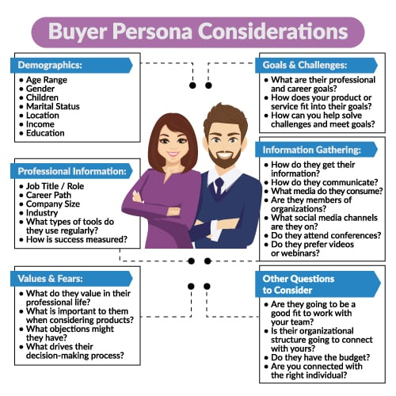
Part 1: Brand study, Competitor Analysis & Buyer’s/Audience’s Persona
Buyer's/Audience's Persona: Clearly define the target audience for the chosen brand. Consider demographics, psychographics, behaviors, and interests.
AXIS BANK
Demographics :
Age Range: above 18
Gender : All
Children: not eligible (minor)
Marital status : Both (married/unmarried)
Location : All over INDIA
Income : 3,00,000
Education : 10+2
Information Gathering :
How do they get their information:
Community platforms , You tube ads , Facebook and
Instagram ads.
Values / fears:
What do they value in their professional life :
Customer Centricity, Ethics, Transparency, Teamwork and Ownership

Slide 6
Part 2: SEO & Keyword Research
SEO Audit: Do an SEO audit of the brands website
Keyword Research: Define Research Objectives, Brainstorm Seed Keywords, Utilize Keyword Research Tools (SEMrush or Moz Keyword Explorer),Analyze Competitor Keywords, Long-tail Keyword Exploration (specific, longer phrases) that align with the research objectives and have lower competition but higher conversion potential.
On page Optimization: Meta Tag optimization & content optimization
Reflect on the process of conducting keyword research and the SEO recommendations provided.
Document the challenges faced during the research and analysis phase, as well as the key insights gained from the keyword research process.

Slide 7
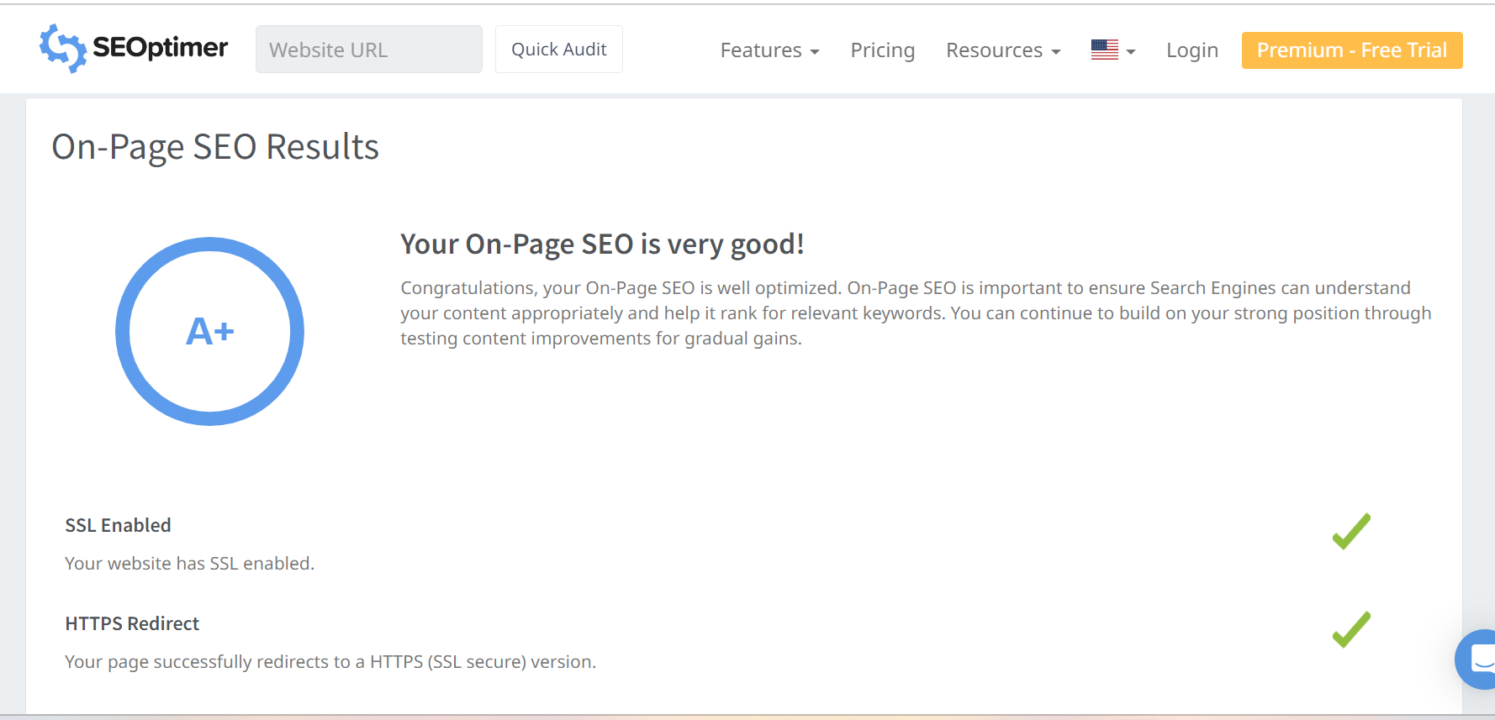
SEO Audit: Do an SEO audit of the brands website
SEO Audit: Do an SEO audit of the brands website.

Slide 8
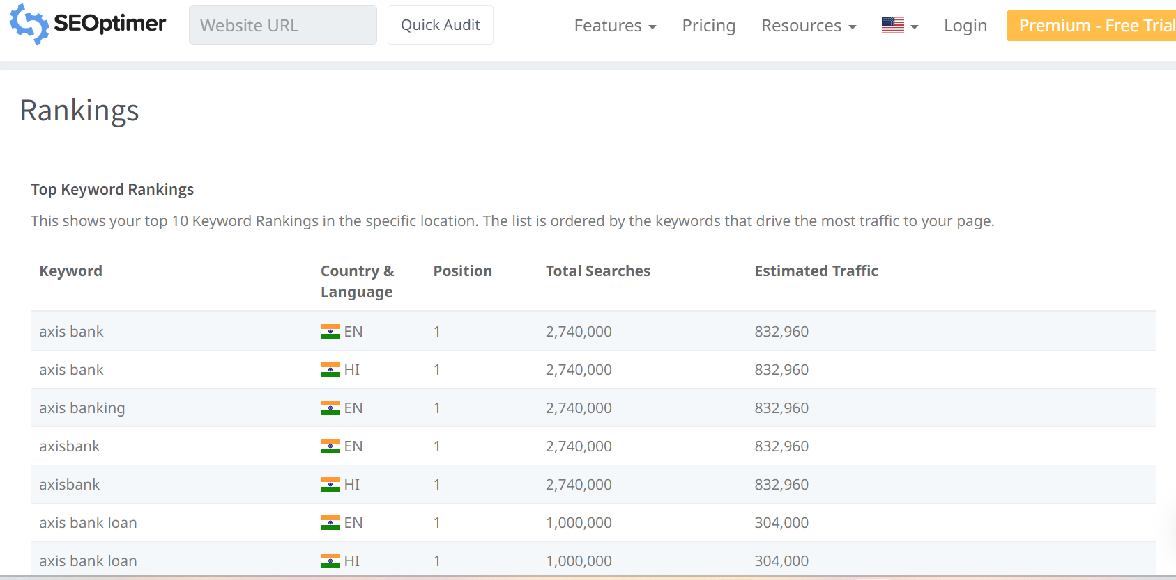
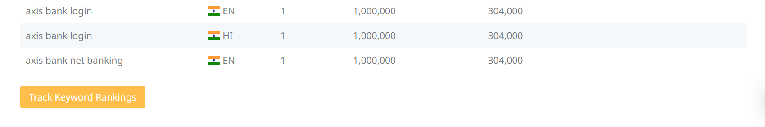

Slide 9
Keyword Research
keyword : LOAN
Keyword | Avg. monthly searches | Competition
mudra loan | 500000 | Low
car loan | 50000 | Low
kcc loan | 50000 | Low
Meta Tittle
Check the best loans for mudra,car and mudra loans
Meta Description
Apply for low interest rate of car loan,kcc loan & mudra loan at our Axis Bank
Keyword : Loan interest rate
Keyword | Avg. monthly searches | Competition
axis bank home loan | 50000 | Low
axis bank home loan interest rate | 50000 | Low
axis bank personal loan interest rate | 50000 | Low
Meta Title
Check the interest of personal & homeloan rate at our bank |  |  | Y
Meta Description
Apply now to get more benefits for home and personal loan at our axis bank

Slide 10
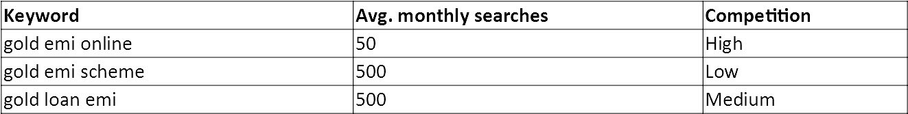
Keyword : calculator
Keyword | Avg. monthly searches | Competition
savings account interest calculator | 5000 | Low
interest calculator savings | 5000 | Low
axis bank home loan calculator | 5000 | Low
Meta Tittle
Check your saving account,intrest & home loan calculator
Meta Description
Apply for more features for home loan and personal loan at our axis bank
Keyword : emi
Meta Tittle:
Explore new options like gold emi online,gold emi scheme,gold loan emi
Meta Description:
Check the interesting gold emi online, gold emi scheme,gold loan emi at Axis Bank

Slide 11
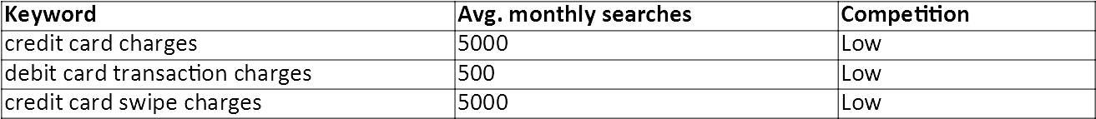
Keyword : Charges
Meta Title:
Check the charges of Credit card,debit card & credit card swipe charges
Meta Description:
Apply feautured Loans like Home loan, Mudra Loan, Student Loan from AXIS bank

Slide 12
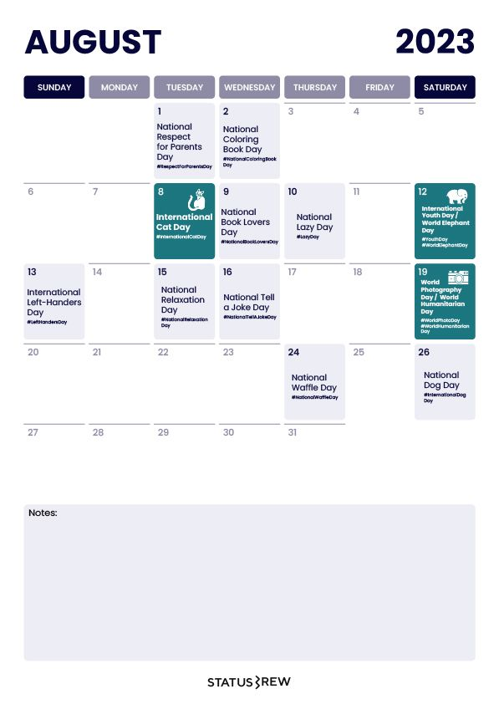
Part 3: Content Ideas and Marketing Strategies
Content Idea Generation & Strategy: Create a content calendar for the remaining month of July by brainstorming content themes, exploring various formats like blog posts, videos, infographics, podcasts, and interactive quizzes, and scheduling publication dates mainly on Facebook & Instagram.
And include the strategy, aim and the idea behind these posts and story
Content Calendar Example (Try creating a table for the month of July)

Slide 13



Part 3: Content Ideas and Marketing Strategies
Date :5th August
To make banking services more convenient for our customers . Implement a virtual ATM assistance customers can pre-select their transaction preferences, reducing the Implement a virtual ATM assistance customers can pre-select their transaction preferences, reducing the
Date :6th August
To excite customers about the convenience and efficiency of the bank's new digital services. Encouraging customers to use their banking transactions at online or digital banking.
Date :7th August
A clear information gives to customers about digital banking and also customers can easily use digital banking and we encourage customers to use digital banking features.It helps to easy banking transactions.

Slide 14
Part 3: Content Ideas and Marketing Strategies
Reflect on the content ideas and marketing strategies process, discussing the challenges encountered and lessons learned.
Creating content ideas and devising effective marketing strategies is a dynamic process that involves continuous learning and adaptation. Throughout this journey, several challenges and valuable lessons can be encountered.
1.Understanding the Audience: One of the primary challenges is comprehending the target audience's preferences, needs, and pain points.
2. Generating Unique Ideas: Coming up with fresh and innovative content ideas can be difficult, especially in saturated markets.
3. Consistency and Quality: Maintaining a consistent flow of high-quality content can be demanding. Setting up an editorial calendar and adhering to a content creation schedule helps in maintaining quality and meeting deadlines.
4. Content Promotion: Even the best content may not gain traction without proper promotion. Crafting effective marketing strategies to reach the target audience across various channels is crucial for success.
5. Collaboration: Collaborating with influencers or other brands can amplify the reach of content and strengthen marketing efforts.
The content ideas and marketing strategies process is an iterative and learning-oriented journey

Slide 15
Part 4: Content Creation and Curation (Post creations, Designs/Video Editing, Ad Campaigns over Social Media and Email Ideation and Creation)
Post Creation:
Select Content Categories: Identify three different content formats relevant to the chosen topic or industry. Research and Brainstorm: Research trending topics, industry news, or audience interests within each category. Brainstorm ideas for social media posts that align with each category. Do note that 1 content format has to be video and additionally 3 stories/status are to be created.
Format 1 : Blog article
Format 2 : Video
Format 3 : Creative

Slide 16
Part 4: Content Creation and Curation (Post creations, Designs/Video Editing, Ad Campaigns over Social Media and Email Ideation and Creation)
Format 1 : Blog Article
Aim : To make banking services more convenient for our customers .
Date : August 5th 2023
Idea : Implement a virtual ATM assistance customers can pre-select their transaction preferences, reducing the . time spent on the actual ATM.
Topic: Streamlining ATM Transactions with Virtual ATM Assistants
Introduction
As technology continues to advance, businesses are looking for innovative ways to improve customer experiences and increase efficiency. One such advancement is the integration of virtual ATM assistants, which allow customers to pre-select their transaction preferences before arriving at the ATM..
Step 1: Understanding Customer Needs
Before developing the virtual ATM assistant, it's crucial to analyze your customers' needs and preferences. Conduct surveys, focus groups, or use data analytics to gather insights into the most common ATM transactions, security concerns, and any other relevant factors that impact customer experience.
options and additional security measures based on customer feedback and changing technological trends.

Slide 17
.
.
Step 2: Define Transaction Preferences
Based on the data collected in Step 1, determine the set of transaction preferences customers can pre-select. Typical preferences may include:
Language selection
Transaction type (withdrawal, deposit, balance inquiry, funds transfer, etc.)
Preferred account (checking, savings, etc.)
Withdrawal amount limits
Receipt options (email, print, or none)
Step 3: Design User-Friendly Interface
Create an intuitive and user-friendly interface for customers to set their preferences. This interface can be a mobile app, a web portal, or integrated into the bank's existing mobile banking app. The design should be visually appealing and accessible to customers of all age groups.
Step 4: Security Measures
Security is of utmost importance when dealing with financial transactions. Implement multi-factor authentication, including password and biometric verification, to ensure the customer's identity is secure. Utilize encryption protocols to protect data transmitted between the virtual assistant and the ATM system.
Step 5: Backend Integration
Integrate the virtual ATM assistant with the bank's ATM network and core banking system. This will require collaboration between the bank's IT team and the development team responsible for the virtual assistant. The integration should allow , perform security testing to validate .

Slide 18
.
Step 6: Testing and Quality Assurance Thoroughly test the virtual ATM assistant to identify and resolve any bugs or issues. Conduct usability testing to ensure the interface is easy to navigate and understand. Additionally, perform security testing to validate the system's resistance to potential cyber threats. Step 7: Pilot Program and Feedback Before a full-scale launch, run a pilot program with a small group of customers to gather feedback. Encourage users to share their experiences and provide suggestions for improvement. Use this feedback to make necessary adjustments and enhancements to the virtual assistant system. Step 8: Launch and Marketing With all the necessary refinements in place, launch the virtual ATM assistant to the broader customer base. Conduct marketing campaigns to raise awareness about the new feature and its benefits. Highlight how the virtual assistant saves time, enhances security, and improves overall ATM transactions. Step 9: Continuous Improvement The launch of the virtual ATM assistant is not the end; it's just the beginning. Continuously monitor its performance, collect user data, and seek ways to enhance the system further. Incorporate new transaction

Slide 19
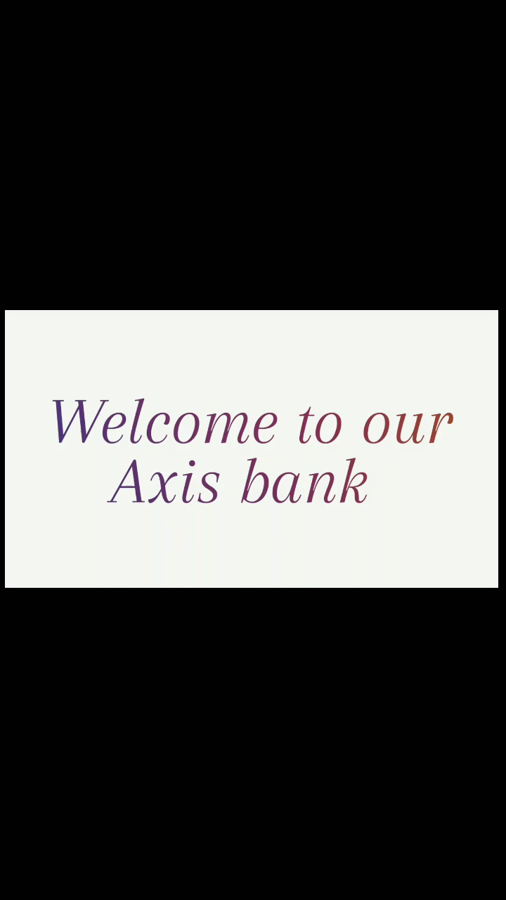
Part 4: Content Creation and Curation (Post creations, Designs/Video Editing, Ad Campaigns over Social Media and Email Ideation and Creation)
Format 2 : VIDEO
Aim : To excite customers about the convenience and efficiency of the bank's new digital services
Date : August 6th 2023
Idea: Encouraging customers to use their banking transactions at online or digital banking.

Slide 20

Part 4: Content Creation and Curation (Post creations, Designs/Video Editing, Ad Campaigns over Social Media and Email Ideation and Creation)
Format 3 : Creative
Aim : To create a poster on Digital banking
Date : August 7th 2023
Idea : A clear information gives to customers about digital banking with a Poster
Topic : Poster

Slide 21
Part 4: Content Creation and Curation (Post creations, Designs/Video Editing, Ad Campaigns over Social Media and Email Ideation and Creation)
Instagram Story
Utilize the Stories feature on Instagram for three consecutive days. Share behind-the-scenes glimpses, polls, quizzes, or sneak peeks etc to encourage audience participation. Once uploaded use the story highlight feature on Instagram and save the 3 story with an appropriate name for each.
Note:
Once done monitor the performance of the posts and Stories using the insight tool and analyze the engagement metrics (likes, comments, shares, impressions, etc.). Based on the analysis, mention the strategies and areas for improvement.

Slide 22
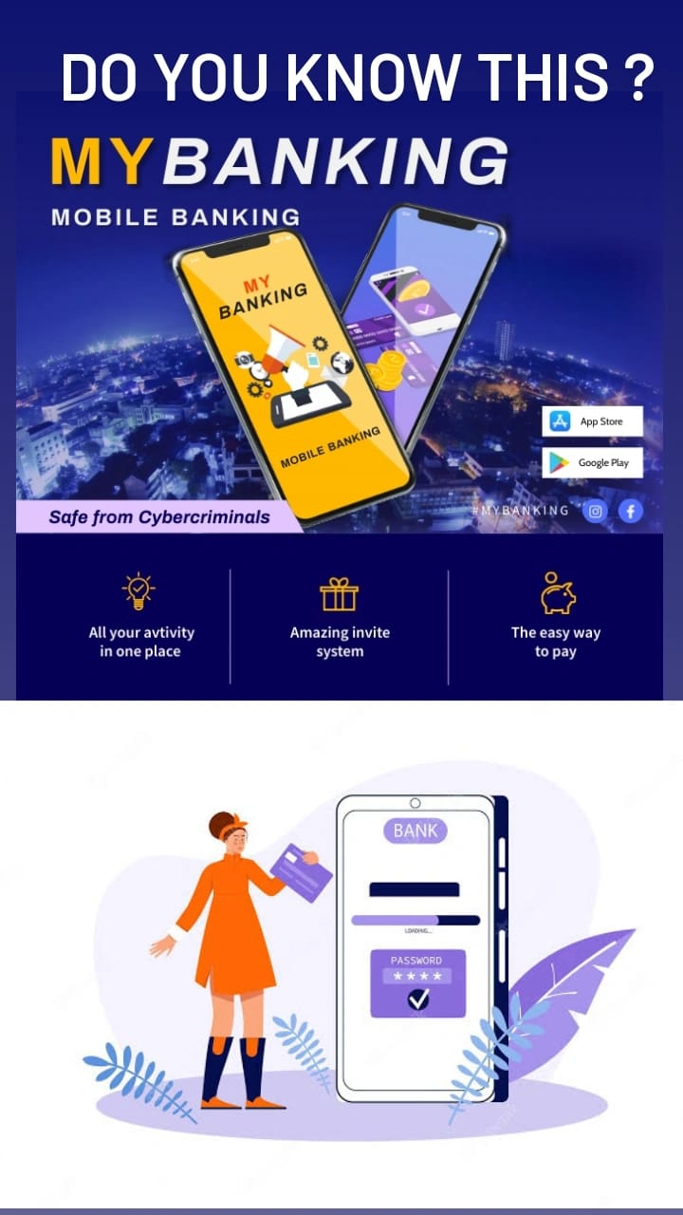
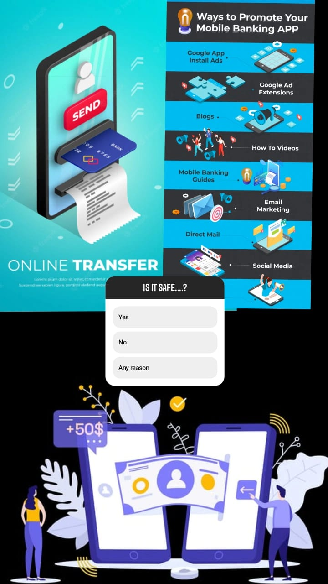
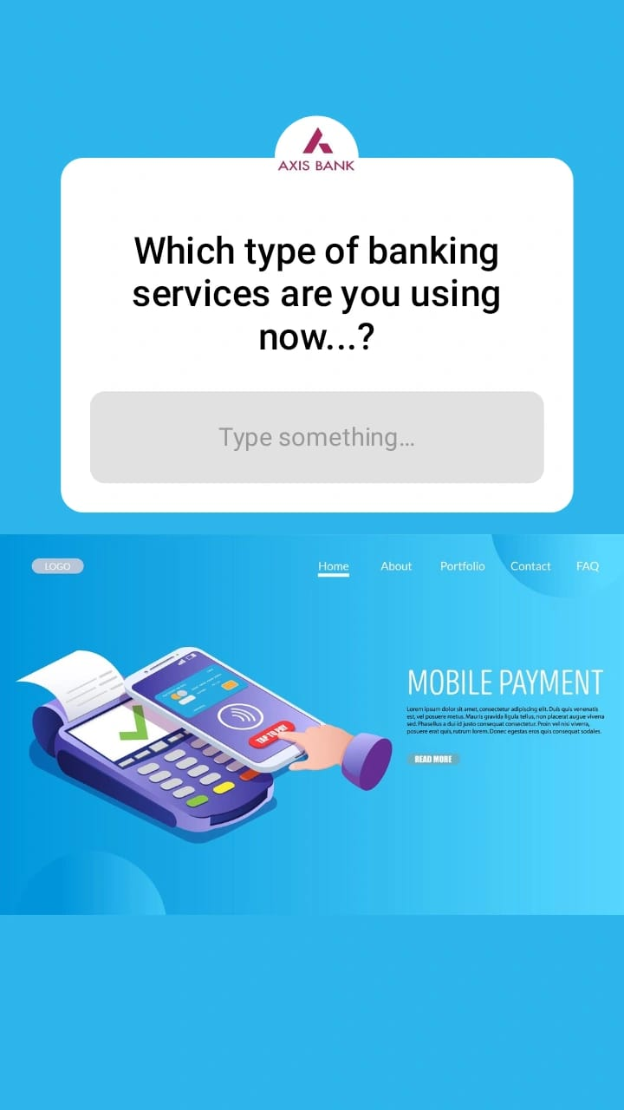
Part 4: Content Creation and Curation (Post creations, Designs/Video Editing, Ad Campaigns over Social Media and Email Ideation and Creation)
Instagram Story

Slide 23
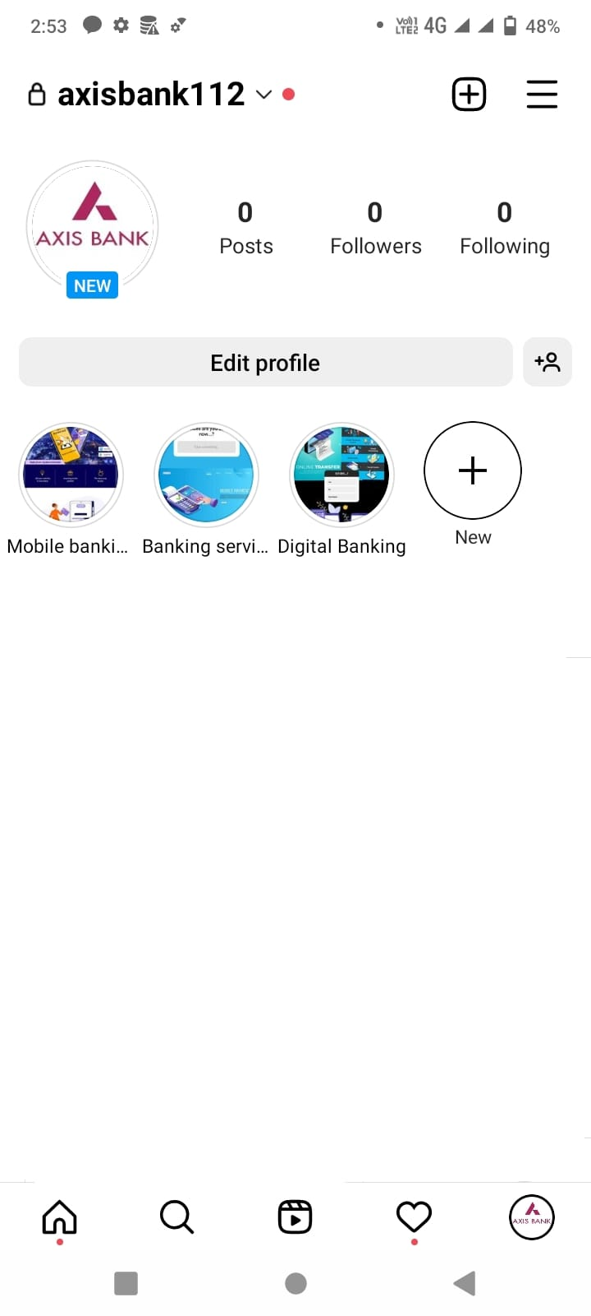
.

Slide 24

Part 4: Content Creation and Curation (Post creations, Designs/Video Editing, Ad Campaigns over Social Media and Email Ideation and Creation)
Designs/Video Editing
Design Tools Familiarization (use Canva for creating visually appealing graphics)
Video Creation: Utilize VN or any video editor of your choice to create videos related to the chosen topic.

Slide 25
Part 4: Content Creation and Curation (Post creations, Designs/Video Editing, Ad Campaigns over Social Media and Email Ideation and Creation)
Social Media Ad Campaigns
Ad Campaigns over Social Media:
Come up with 3 ad campaigns each covering one of the mentioned goals: brand awareness, driving website traffic, or generating leads

Slide 26
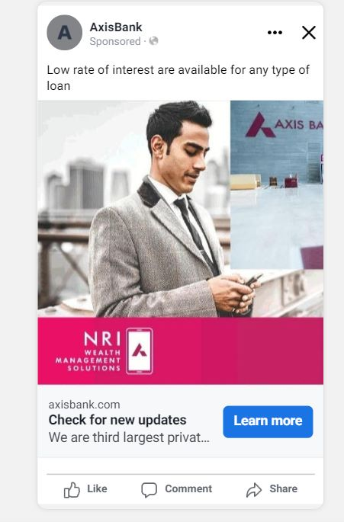
Brand awareness : Targeting : Location: India, Gender: All, interest : Debit card and credit card , loans.

Slide 27
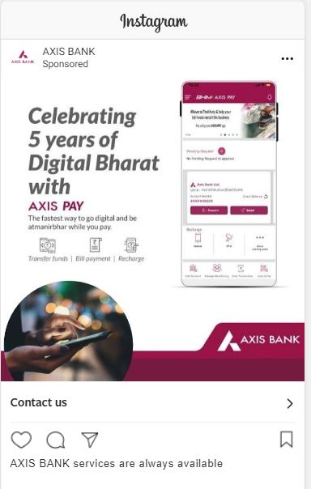
Driving website traffic:
Targeting : Location: India, Gender: All, interest : Debit card and credit card , loans.

Slide 28
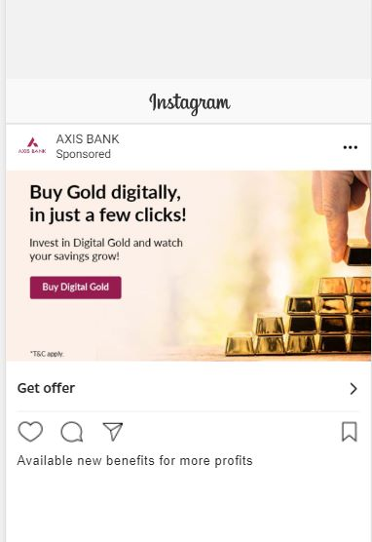
Generating leads :
Targeting : Location: India, Gender: All, interest : Debit card and credit card , loans.

Slide 29
Part 4: Content Creation and Curation (Post creations, Designs/Video Editing, Ad Campaigns over Social Media and Email Ideation and Creation)
For every campaign clearly define:
Advertising Goals: increasing brand awareness, driving website traffic, or generating leads.
Audience Targeting: Define the target audience for the ad campaigns based on demographics, interests, and behavior.
Ad Creation: Create visually appealing ad creatives, compelling ad copy and relevant call-to-action.

Slide 30
Part 4: Content Creation and Curation (Post creations, Designs/Video Editing, Ad Campaigns over Social Media and Email Ideation and Creation)
Email Ad Campaigns
Ad Campaigns for email marketing:
Come up with 2 email ad campaigns with the mentioned goals: brand awareness & generating leads

Slide 31
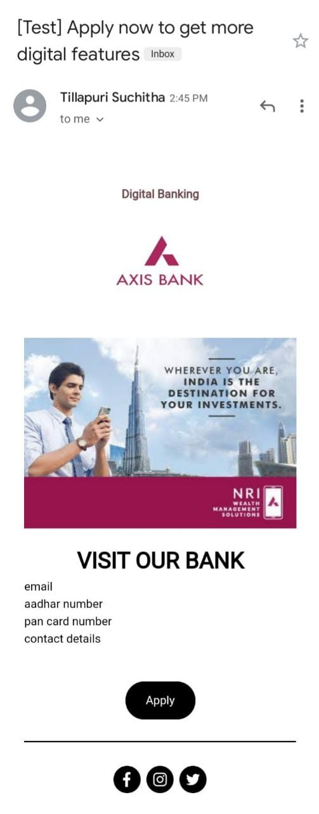
Email Ad Campaign 1 - Brand Awareness
(insert emailer image)

Slide 32
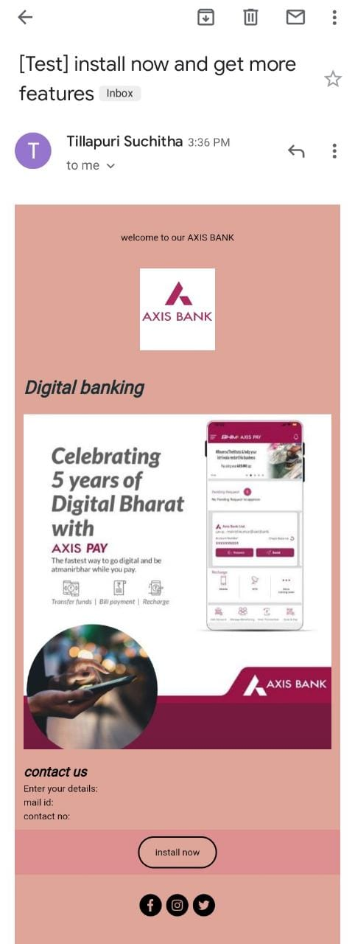
Email Ad Campaign 2 - Lead Generation
(insert emailer image)

Slide 33
Part 4: Content Creation and Curation (Post creations, Designs/Video Editing, Ad Campaigns over Social Media and Email Ideation and Creation)
Reflect on the content ideas and marketing strategies process, discussing the challenges encountered and lessons learned.
1.Know our Audience: Understanding the target audience's interests, pain points, and preferences is fundamental in creating relevant and engaging content.
2.Visual Appeal: Eye-catching visuals, well-designed graphics, and professionally edited videos can significantly enhance the impact of content and ad campaigns.
3. Consistency is Key: Maintaining a consistent tone, style, and frequency of content across platforms helps reinforce brand identity and improves audience recall.
4. A/B Testing: Regularly conducting A/B + tests for ad campaigns and email subject lines allows for data-driven optimization and better results.
5. Engage with the Audience: Responding to comments, messages, and feedback from the audience fosters a sense of community and builds trust.
6. Long-Term Approach: Content creation and marketing are not one-time endeavors. A long-term, strategic approach is necessary to build brand awareness and achieve sustainable growth.
In conclusion, content creation and curation, along with thoughtful design, video editing, and well-executed ad campaigns, play a pivotal role in a successful marketing strategy. By understanding the challenges and incorporating the lessons learned, businesses can create compelling content that resonates with their target audience and drives results

